Slide 1
CLASSIFICATION OF PLANT SEEDLINGS
- By Team 8

Slide 2
Team Members
Team Members | Roles
K. Shiva Ram | ML/AI Manager
G. Vinay Kumar | Business manager
P. Charithesh | ML/AI Manager
D. N. S. V. Sreeja. T | Sales specialist
P. Rahul Sai | Application Architect
T. Shiva Sai | Solution Specialist
K. Preethi | Research Member
Spandana | Research Member
S.P.Shanmukhi | Research Member

Slide 3

Problems faced by the clients
In seed identification the particular seed in question must be identified up to the species level.
The size, shape and color of seeds.
The shape and position of the attachment scar
The presence of wings, hair or scale, spines etc.
The internal structure, position and size of the embryo presence or absence of the endosperm

Slide 4

Technology used
Keras :
Keras is an open-source neural-network library written in Python . Keras contains numerous implementations of commonly used neural-network building blocks such as layers, objectives, activation functions, optimizers, and a host of tools to make working with image and text data easier.
Tensor Flow:
Tensor Flow is an end-to-end open source platform for machine learning. It has a comprehensive, flexible ecosystem of tools, libraries and community resources that lets researchers push the state-of-the-art in ML and developers easily build and deploy ML powered applications.

Slide 5
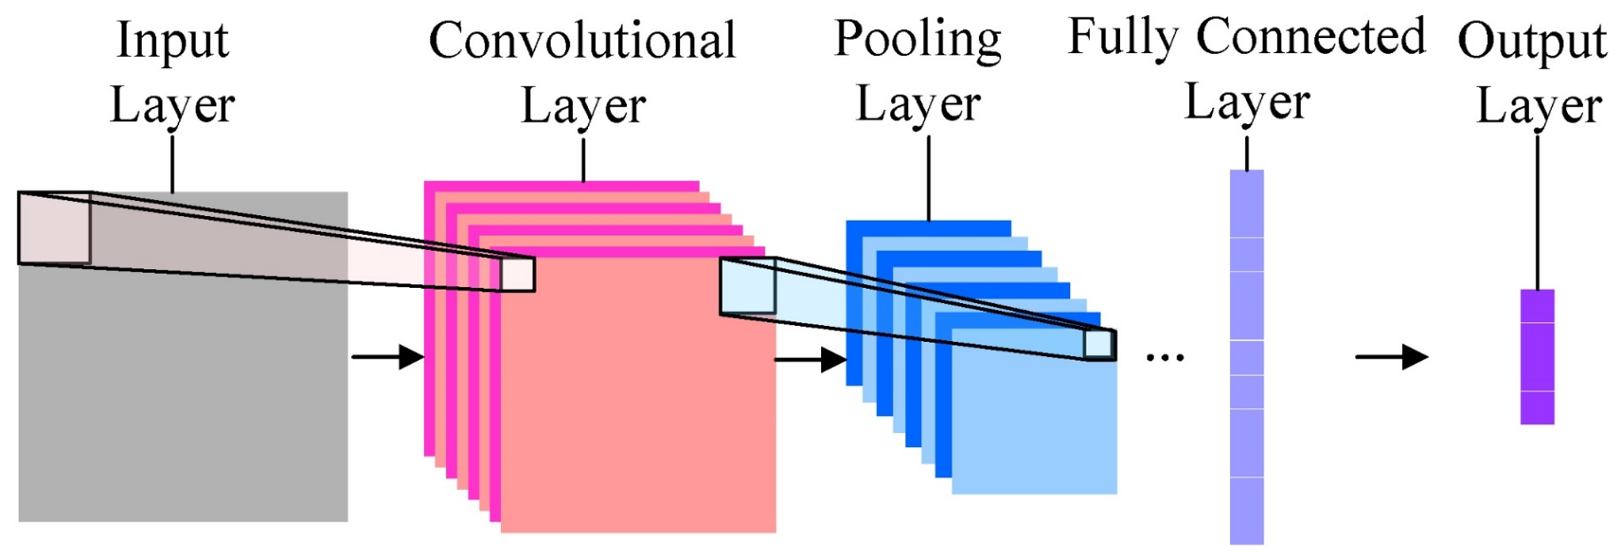
TECHNIQUE USED
CONVOLUTIONAL NEURAL NETWORKS:
Convolutional neural networks have been one of the most influential innovations in the field of computer vision. They have performed a lot better than traditional computer vision and have produced state-of-the-art results. These neural networks have proven to be successful in many different real-life case studies.

Slide 6
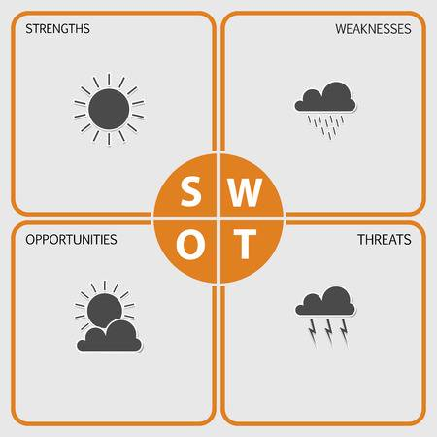
SWOT ANALYSIS
Strength:
Able to classify 12 different types of species.
Simple
92% accuracy
Weakness:
Not 100% accurate
Limited Datasets for training the model
Opportunities:
We can eliminate weeds in a crop.
We can predict any plant and know what kind of species and it’s threats
Threats:
It can be easily plagiarized.

Slide 7

ADVANTAGES
It is more efficient in terms of memory and complexity.
It automatically detects the important features without any human supervision
It is computationally efficient

Slide 8

APPLICATIONS
Used to detect weeds in a farm.
Specific extinct species of plants can
be detected and can be preserve.
Can be used for scientific research

Slide 9

CONCLUSION
During the work in this doctoral thesis, several experiments were performed using image processing and machine learning algorithms for the purpose of plant species recognition and weed detection.
The proposed architecture resolves two major challenges:
The need for larger datasets for obtaining models with higher level of generalization.
The need for high-end hardware processing configurations to train the weed detection models

Slide 10
THANKS!
Any questions?

